Slide 1


ASANAS
Physical Postures
www.manavata.org

Slide 2
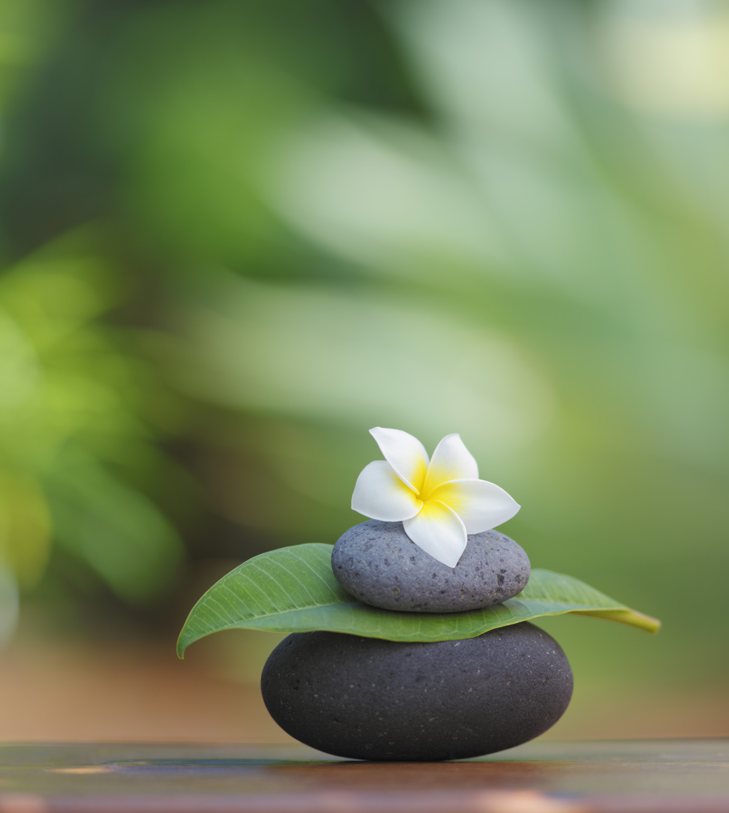

Slide 3
STARTING PRAYER
“Om Sahanavavatu, Sahanou bhunaktu,
Saha viryam karavavahai,
Tejasvinavadhitamastu, ma vidvisavahai
Om Santih, Santih, Santih”
Meaning:
May he protect us both (the teacher and the student). May he nourish us both. May we both work together with great energy. May our study be enlightening and fruitful. May we not hate each other. Om Peace, Peace, Peace.

Slide 4
Closing Prayer
“ Yogena Cittasya Padena Vacam,
Malam Sarirasya Ca Vaidyakena,
Yo Pakarotam Pravaram Muninam,
Patanjalim Pranjaliranatosmi,
Om Santih Santih Santih.”
Meaning:
I offer my salutations with fold hands to patanjali the renowned amongst the sages, who removed the impurity of mind through yoga, of speech by grammar and of body by ayurveda. Om peace peace peace.

Slide 5
Asana Class – Outline
Breathing Exercises - 8 (For correction of breathing)
IRT (Instant Relaxation Technique)
Loosening Exercises - 5 (To remove Tamas)
QRT (Quick Relaxation Technique)
Surya Namaskar (Dynamic postures)
Yogasanas - 23 postures
DRT (Deep Relaxation Technique)

Slide 6
Breathing Exercises
The respiratory system is a bridge between the conscious and subconscious, voluntary and involuntary or in general body and mind.
Using the voluntary control we change the involuntary functions.

Slide 7
Principles of Breathing Exercises
Slowness
Awareness
Synchronizing the movement with the breathing.
Exhalation should be longer than Inhalation.
Ability to increase and decrease the breathing rate.
No tightness in the body.

Slide 8
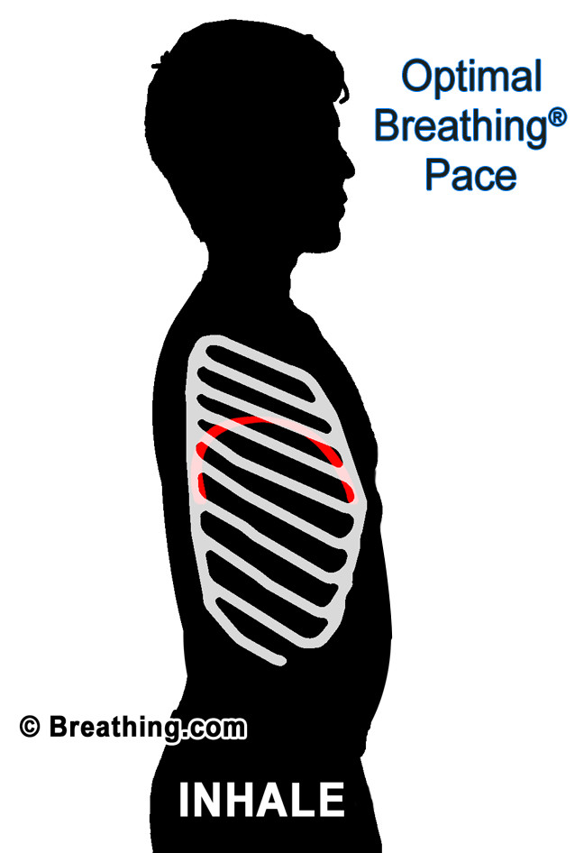
OBJECTIVES OF BREATHING PRACTICES
To utilize all the lobes of the lungs.
To normalize the breathing (slow and smooth).
To make the breathing uniform, continuous and rhythmic.

Slide 9
TIPS
Emphasize the movement of hands, legs, abdominal and thoracic muscles as needed in each exercise.
Use ‘in and out’ instructions in the mind.
Emphasize on full breathing each time.
Synchronize the breathing with corresponding movements.
Develop an awareness of breathing.
Close the eyes and repeat a few rounds retaining the awareness.

Slide 10
HANDS IN AND OUT BREATHING
Sthiti : Tadasana
Relax : Sithila Tadasana
Feel the changes in:
                Breath
                Arms
                Shoulders
                Back
                Neck

Slide 11
HANDS STRETCH BREATHING
Sthiti : Tadasana
Relax : Sithila Tadasana
At 90, 135, and 180 degrees

Slide 12
Note
Collapse the shoulders at the beginning and end of each cycle.
Maintain perfect awareness of the breathing.
Exhalation should be longer than inhalation.
If required, it can be practiced sitting in a chair too.
Synchronize the breathing with hand movements
Balance the Prana in the chest.
Improves concentration and calms down the mind.

Slide 13
Benefits:
Helps in opening the lower, middle and the upper part of the chest.
Balancing Prana.
Promotes rhythmic breathing.
Increases awareness of breathing.
Improves concentration and calms down the mind.

Slide 14
ANKLES STRETCH BREATHING
Sthiti : Tadasana
Relax : Sithila Tadasana
Note
Eyes open
Fix your gaze on a point in front of you.
Feel the stretch from ankle to finger.
Enjoy the stability

Slide 15
Benefits:
Increases awareness of breathing.
Strengthens the clavicular muscles.
Improves awareness of middle part of lungs.
Improves the capacity to focus.
Relaxes and balances the body.
Calms down the mind.
Balances the Prana.

Slide 16


Slide 17
4. DOG BREATHING
Sthiti : Vajrasana
Relax : Sasankasana
Note
Keep your mouth open.
Tongue is pushed out to its maximum.
Practice rapidly.
Forceful inhalation & exhalation.
Abdominal breathing.

Slide 18
Limitations
Epilepsy
High Blood Pressure
Benefits:
Increased diaphragm contraction empties lungs
Rapid exhalation cleanses the lungs.
Increases awareness of middle and lower part of lungs.
Open up Prana blocks.
Calms down the mind.

Slide 19
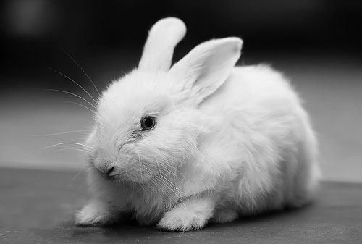

Slide 20
5. RABBIT BREATHING
Sthiti : Vajrasana
Relax : Sasankasana
Note
Breathing rapidly through mouth only.
Thoracic breathing.
Abdomen is pressed on thigh
No abdominal movement.
Do not drop head on the floor.

Slide 21
Benefits:
Helps in acute episodes of asthma.
Develops voluntary control of muscles of lungs.
Opens up Prana blocks.
Quick way to calm down the mind.

Slide 22
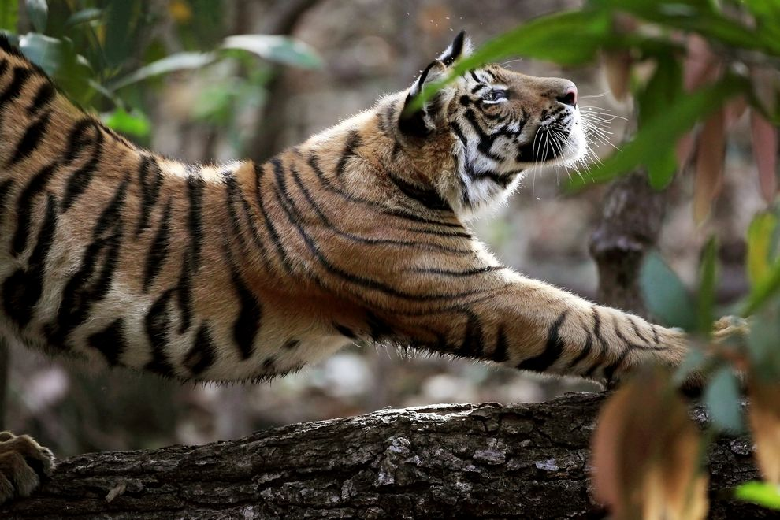

Slide 23
6. TIGER BREATHING
Sthiti : Dandasana
Relax : Sasankasana
Note
Ensure that you are comfortable with the posture before starting.
Co-ordinate the movements with breathing.
Eyes closed, practice with awareness.
No movement of arms and thighs.
Awareness on spinal movement.

Slide 24
Tiger Breathing
Benefits:
Awareness and mastery over all three sections of the chest.
Empties the lungs fully.
Harmonize the muscles of respiration.
Calms down the mind.
Feed back of airway status by sound in case of asthmatics.

Slide 25


Slide 26
7. SASANKASANA BREATHING
Sthiti : Vajrasana
Relax : Sasankasana
Note
Exhale and collapse the shoulders.
If necessary, apart knees to avoid unnecessary pressure on the abdomen and chest.
Synchronize breathing with movement.
Close the eyes.
Awareness on the breathing.

Slide 27
Benefits:
Expels air trapped in lower part of lungs.
Trains diaphragmatic breathing.
Release Pranic blocks.
Calms down the mind.

Slide 28
8. STRAIGHT LEG RAISE BREATHING
Sthiti : Supine Posture
Relax : Savasana
Stage I : Alternate legs
Stage II : Both legs

Slide 29
Note
Keep arms either by side of the body or above the head.
Do not bend the knees.
Do not disturb the leg lying straight on the ground.
Do not raise the leg beyond 90 degree.
Synchronize the breathing with the leg movement.
In the case of both legs, use strength and have control over the movement.
Benefits:
Reduces abdominal fat.
Tones abdominal muscles.

Slide 30
I.R.T. (Instant Relaxation Technique)
Bring your legs, heels, toes together and palms by the side of the thighs. Gently bring your awareness to the tip of the toes.
Stretch the toes, tighten the ankle joints, and tighten the calf muscles. Pull up the knee caps. Tighten the thigh muscles. Compress and squeeze the buttocks.
Exhale and suck in the abdomen. Make the fists of the palms and tighten the arms. Inhale and expand the chest. Tighten the shoulders, neck muscles and compress the face.
Tighten the whole body from the toes to the head. Tighten… tighten… tighten… Release and relax.
Legs go apart, arms go apart, palms facing the roof. Assume the most comfortable position; let the whole body sink down.
Let all the groups of muscles beautifully relax. Collapse the whole body. Enjoy the relaxation.

Slide 31
Loosening Exercises
(Sithilikarna Vyayama)
Principles
To loosen the various joints in the body.
Flexibility of the spine
Objectives
Remove lethargy and tiredness in the body.
Build up the stamina of the body.
Discipline the body-mind complex.

Slide 32
TIPS
Practice the exercises stepwise.
Count the steps slowly and perform the same with attention.
Check the performance of each step before increasing the speed.
Synchronize steps with group.
Increase the number of repetitions as per your capacity.

Slide 33
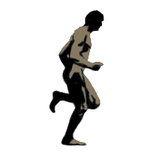
1. JOGGING
Sthiti : Tadasana
Relax : Sithila Tadasana
Stage I : Slow Jogging.
Stage II : Forward Jogging.
Stage III : Backward Jogging.
Stage IV : Side Jogging.

Slide 34
Note
Loose fists and place them on the chest.
Collapse and relax shoulders.
Increase the speed of jogging gradually.
Continue the practice till 4 stages of jogging.
Fists on the chest throughout the practice.
Benefits:
Tones up the calf and thigh muscles.
Warm up the body.
Stimulates breathing.

Slide 35
Mukha Dhouti to Relax
Benefits:
Through exhalation the strain of jogging and jumping relieves.
Pulling the abdomen inwards, during exhalation can improve the force of expulsion of air.

Slide 36
2. FORWARD AND BACKWARD BENDING
Sthiti : Tadasana
Relax : Sithila Tadasana
Note
Start slowly and increase gradually.
Practice with either legs apart or together.
Swing the body when bending forward.
Always bend from the lower waist.
Make the movements free, easy and flowing.

Slide 37
Benefits:
Reduces fat from waist, back and specially from abdominal region.
Increased flexibility of spine.
Increases exercise tolerance; helpful in exercise induced asthma.
Expels blocked air from the lungs.
Expels phlegm from the air ways.
Harmonize flow of Prana.
Calms down the mind.

Slide 38
3. SIDE BENDING
Sthiti : Tadasana
Relax : Sithila Tadasana
Note
Legs about one meter apart.
Avoid forward or backward bending.

Slide 39
Benefits:
Open up the airways of middle lobes of lungs.
Calms down the mind.
Strengthens middle part of chest.
Empties middle and upper part of lungs.
Stimulates middle lobe of the lungs.

Slide 40
4. TWISTING
Sthiti : Tadasana
Relax : Sithila Tadasana
Note
Legs to be firm on the ground.
While twisting side to side, look at the side of the finger.
All twisting should be above the waist level.
Keep the body below the waist, straight and firm.
Do not bend the knees

Slide 41
Benefits:
Reduces fat from the waist and abdomen.
Increases flexibility of spine.

Slide 42
5. PAVANAMUKTASANA KRIYA
Shiti : Supine Posture
Relax : Savasana
Stage I : Leg Rotation
Stage II : Rocking And Rolling
Note
Try to draw as big a circle as possible while rotating.
Maintain the compression around the abdomen to have the best result.
Do not bend the leg at the knee, which is being rotated.

Slide 43
Benefits:
Reduces the abdominal fat.
Releases the gas accumulated in digestive tract and improves digestion.
Improves appetite.
Prevents constipation.
Releases Prana blocks.

Slide 44
Q R T (Quick Relaxation Technique)
Stage I- Observation
    Observe your abdominal movements.
Stage II- Recognition
    Synchronize your abdominal movements with your breathing.
Stage III- Sensitization
    Feel the relaxation and fresh energy in the body. Also, feel the temperature of the air as well as the feeling of the breath.

Slide 45


Slide 46
Suryanamaskar
Prayer
“Hiranmayena Patrena
Satyasyapihitam Mukham
Tat tvam Pusan Apavrnu
Satya Dharmaya Drstaye”
Meaning:
Like a lid to a vessel, O sun your golden orb covers the entrance to truth. Kindly open the entrance to lead me to truth.

Slide 47
TIPS
Do at sunrise and sunset, facing the Sun.
Practice after loosening exercises and before Asanas.
Combination of Yogasana and Pranayama.
Two modes of doing Suryanamaskara 12 steps and10 steps.
With each round, chant BIJAMANTRA with name of the SUNGOD.

Slide 48
BIJA MANTRA
Aum Hram Mitraya Namah
Aum Hrim Ravaye Namah
Aum Hrum Suryaya Namah
Aum Hraim Bhanave Namah
Aum Hroum Khagaya Namah
Aum Hrah Pusne Namah
Aum Hram Hiranyagarbhaya Namah
Aum Hrm Maricaye Namah
Aum Hrum Adityaya Namah
Aum Hraim Savitre Namah
Aum Hroum Arkaya Namah
Aum Hrah Bhaskaraya Namah

Slide 49
Benefits:
Increases flexibility of the body.
Tones muscles.
Improves circulation.
Harmonize breathing.
Releases Prana blocks.
Prepares for Asanas and Pranayama.

Slide 50
ASANAS
There are two type of schools of Asana.
Hatha Yoga gives descriptions of Asanas. The schools of Hatha Yoga emphasize on Dynamic Asanas and the schools of Patanjali Yoga emphasize on Relaxing Asanas.
Asana is the one of the limb of Patanjali’s Ashtanga Yoga. Patanjali defines Asana: ‘Sthira-Sukham Asanam’ i.e. The posture should be steady and comfortable.

Slide 51
Dynamic Asanas (Hatha Yoga School)
Utilizes flow, repetitions, maintenance with strength (Isometric) in the mode of performance.
The objective is predominantly shatter the laxity, lethargy and tamas in general.
By repetitions and flow in actions, it develops the strength of the muscles and the stamina of the organs and systems in the body. This aids the growth process and hence it is useful in youngsters.

Slide 52
Relaxing Asanas (Patanjali Yoga School)
The relaxing type of asanas emphasizes on mental equipoise through relaxation and effortlessness.
The objectives are relaxation, slow breathing, calming the mind, energy channelization and conservation and balancing of body functions.

Slide 53
Stages in Yogasana
While maintaining an asana, we go through three stages:
    Sthira (Steadiness)
    Cira: (Endurance with relaxation-‘Prayatna-Saithilya’)
    Sukha: (Comfortable)
If an ‘asana’ becomes effortless and comfortable, mind starts to wander. To avoid this Patanjili suggests ‘Ananta-Samapatti’-contemplation on the infinite. If the posture is ‘Sukha’ for an appreciably long time (subjectively variant) the person enters ‘Asana Siddhi’.

Slide 54
Classification of Yogasanas:
They can be classified in two ways, categorically and type.
Categories:
            Meditative
            Relaxing
            Cultural
Types:
            Standing postures
            Sitting postures
            Prone postures
            Supine postures

Slide 55
Eight Step Method
Of Introducing An Asana
Introduction of the asana:
Name, meaning, sthiti, relaxation, complementary, counts, category and type.
Demonstrations.
    Silent Demonstration
    Demonstration with count
    Demonstration with counts, breathing and explanation.

Slide 56
Benefits and Contra-indications.
Individual Practice.
Practice in Pair.
Questions and Answers.
Key Points.
Group Practice.

Slide 57
1. Ardhakati Cakrasana
(Lateral Arc Posture)
Type : Standing
Category : Cultural
Counts : 4
Compl Posture : Self-complimentary

Slide 58
Benefits
Reduces fat in the waist region.
Stimulates sides of the body.
Gives lateral bending to the spine.
Improves liver function.

Slide 59
No Limitation
Key Points
Elbows straight.
Knees straight.
Lateral bend only at the waist.
Left arm hanging freely.

Slide 60
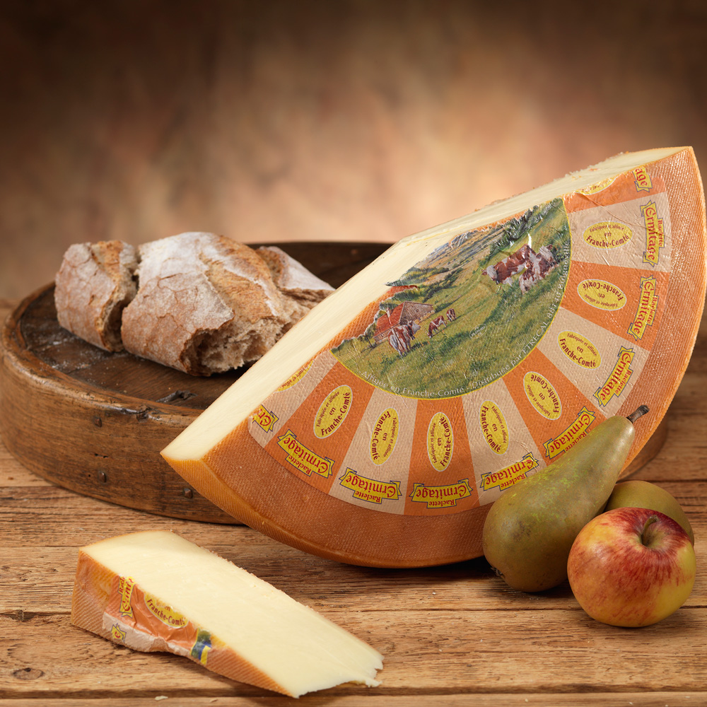

Slide 61
2. Ardha Cakrasana
(Half – wheel posture)
Type : Standing
Category : Cultural
Counts : 4
Compl. Posture : Padahastasana

Slide 62
Benefits
Makes the spine flexible.
Stimulates the spinal nerves
Circulation of blood into the head
Expands chest and shoulders
Limitations
  Cardiac Problems
  Recent abdominal surgery
  Vertigo

Slide 63
Key Points
  All the fingers pointed forward.
  Wrist as close as possible.
  Elbows are close as possible.
  Knees straight.
  Head hanging freely with relaxed neck muscles.
  Bend from the waist.

Slide 64
3. Padahastasana
(Forward-Bend Posture)
Type : Standing
Category : Cultural
Counts : 8
Compl. Posture : Ardha Cakrasana

Slide 65
Benefits
Makes the spine Flexible
Strengthens the thighs
Helps preventing constipation
Helps in menstrual disorders
Improves digestion
Enhances blood flow to the head region.

Slide 66
Limitations
  Vertigo
  Hypertension
  Cervical Spondylosis
  Cardiac Problems
  Spinal Problems
Key Points
  Don’t bend the knees.
  Bend from lower back.
  Maintain the arms in such a way that the biceps are in contact with the ear lobes from step 2 - 6.
  Don’t overstrain.

Slide 67


Slide 68
4. Trikonasa
(Triangle Posture)
Type : Standing
Category : Cultural
Counts : 4
Compl. Posture : Self-compl.

Slide 69
Benefits
Helps in preventing flat foot.
Strengthens the calf and thigh muscles
Strengthens the waist muscles
Make the spine flexible.
Limitations
Undergone recent abdominal surgery
Cardiac Problems
Slip disc
Sciatica

Slide 70
Key Points
Lateral bend only from the waist.
Legs parallel to each other.
Left palm facing forward in the final position.
Hands at 180 degree to each other.

Slide 71


Slide 72
5. Parivritta Trikonasana
(Crossed Triangle Posture)
Type : Standing
Category : Cultural
Counts : 4
Compl. Posture : Self-compl.

Slide 73
Benefits
Gives rotational movement to the spine.
Strengthens the thigh muscles.
Limitations
Spinal problems
Heart problems
Hypertension

Slide 74
Key Points
Bend from lower back.
Knees straight.
Hands in 180 degree.
Foot parallel to each other.

Slide 75
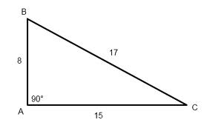

Slide 76
6. Parsva konasana
(Side Angle Posture)
Type : Standing
Category : Cultural
Counts : 8
Compl. Posture : Self-compl.

Slide 77
Benefits
Expands the thorax
Strengthens the thighs
Limitations
Cardiac Problem

Slide 78
Key Points
In Count 3 body facing forward.
In Count 3 90 Degrees angle at the knee.
In Count 3 armpit resting on the knee.
Both soles totally on the ground.
No contraction of the chest. Chest should face forward in the final position.
Left knee should be straight.

Slide 79


Slide 80
7. Vajrasana
(The Ankle Posture)
Type : Sitting
Category : Meditative
Counts : 4
Compl. Posture : Nil

Slide 81
Benefits
Keeps the spine erect and removes drowsiness
Activates Vajranadi
Increases awareness
Reduces Varicose veins.
Limitations: Rheumatic Problems
Key Points
Heels together
Weight of the body on the back of the feet.

Slide 82
8. Sasankasana
(Moon Posture)
Type : Sitting
Category : Cultural
Counts : 8
Compl. Posture : Supta Vajrasana

Slide 83
Benefits
Enhances blood flow to the head.
Stimulates the brain.
Flexibility to the spine, knees and ankles.
Good for breathing ailments.
Limitations: Gastritis and Peptic Ulcer

Slide 84
Key Points
While bending forward allow the abdomen to touch the thighs, chest to knees, and forehead to the ground.
Hips in contact with heels in final position.
Shoulders loose free and relaxed.
While coming up first head raises up then the chest then the abdomen.

Slide 85
9. Supta-Vajrasana
(The Supine Vajrasana)
Type : Sitting
Category : Cultural
Counts : 8
Compl. Posture : Sasankasana

Slide 86
Benefits
Increases the flexibility of the back bone.
Stimulates the spinal nerves.
Stimulates the back muscles.
Improves digestion
Removes constipation.
Mobilizes the hips, ankles and the lower back.

Slide 87
Limitations
Heart problems.
Back problems.
Spondylosis
Key Points
In the final position both knees together and on the ground.
Back of the head on the ground.

Slide 88
10. Pascimotanasana
(Posterior Stretching)
Type : Sitting
Category : Cultural
Counts : 8
Compl. Posture : Ustrasana

Slide 89
Benefits
Flexibility to the back bone.
Stimulates the spinal nerves and back muscles.
Improves digestion.
Removes constipation.
Limitations
Heart ailments.
Back problems and spondylosis.

Slide 90
Key Points
Bend from the lower back.
Knees straight.
From count 2 to 6 maintain both arms in such as way that biceps in contact with ear lobes.

Slide 91
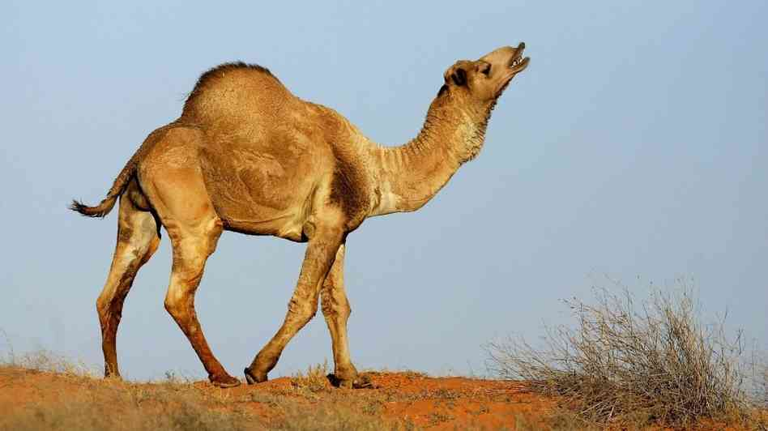

Slide 92
11. Ustrasana
(Camel Posture)
Type : Sitting
Category : Cultural
Counts : 8
Compl. Posture : Pascimotanasana

Slide 93
Benefits
Spine Flexibility.
Circulation to the head.
Prevents breathing problems
Limitations
Recent chest or abdominal surgery.
Hernia.
Severe hypertension.

Slide 94
Key Points
Push the abdomen forward and see that thighs are perpendicular to the ground.
Both legs may be separated by shoulder width apart initially; with practice one can bring them together.

Slide 95
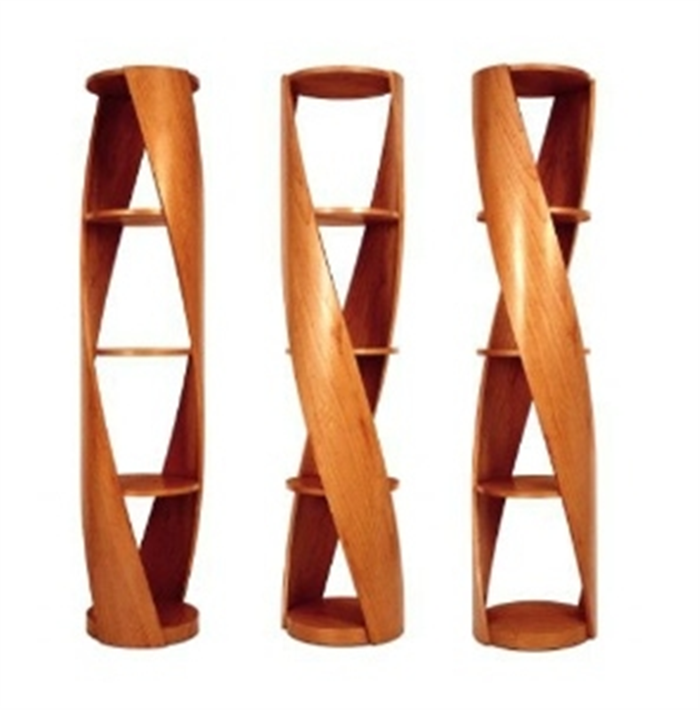

Slide 96
12. Vakrasana
(Twist Posture)
Type : Sitting
Category : Cultural
Counts : 4
Compl. Posture : Self-compl.

Slide 97
Benefits
Flexibility to the spine.
Tones up the spinal nerves.
Cures constipation.
Improves lung capacity.
Limitations: Recent abdominal surgery

Slide 98
Key Points
Middle of the foot by the side of knee.
Pressure of raised leg on abdomen.
Forward stretched leg should be maintained straight.

Slide 99
13. Ardha Matsyendrasana
(Half-twist Posture)
Type : Sitting
Category : Cultural
Counts : 8
Compl. Posture : Self-compl.

Slide 100
Benefits
Flexibility to the spine.
Tones up the spinal nerves.
Cures constipation.
Improves lung capacity.
Limitations: Recent abdominal surgery

Slide 101
Key Points
Left toes and right knee should be in one line
Pressure of the left leg on the abdomen
Twist of the spine
Expansion of the chest
The line joining both shoulders should be parallel to the ground

Slide 102
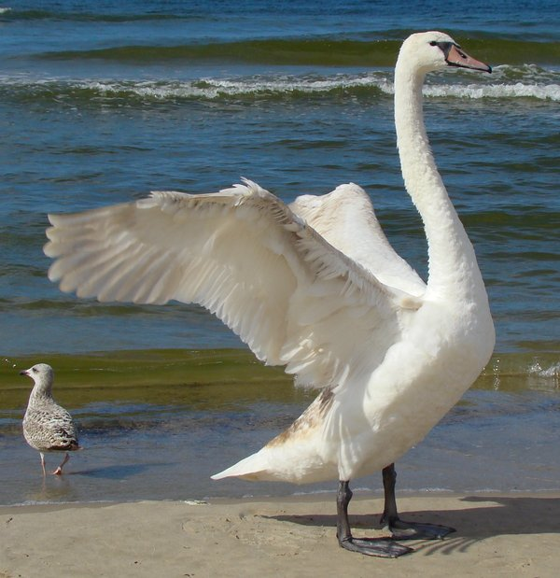

Slide 103
14. HAMSASANA
Type : Sitting
Category : Cultural-Balancing
Counts : 10
Compl. Posture : No compl.

Slide 104
Benefits
Makes the wrists flexible
Arms become strong
Digestion improves
Removes constipation
Limitations
Hernia, hyper acidity and ulcers.
Women with menstrual problems.

Slide 105
Key Points
Both elbows on either sides of the navel
The weight of the body on the abdomen

Slide 106
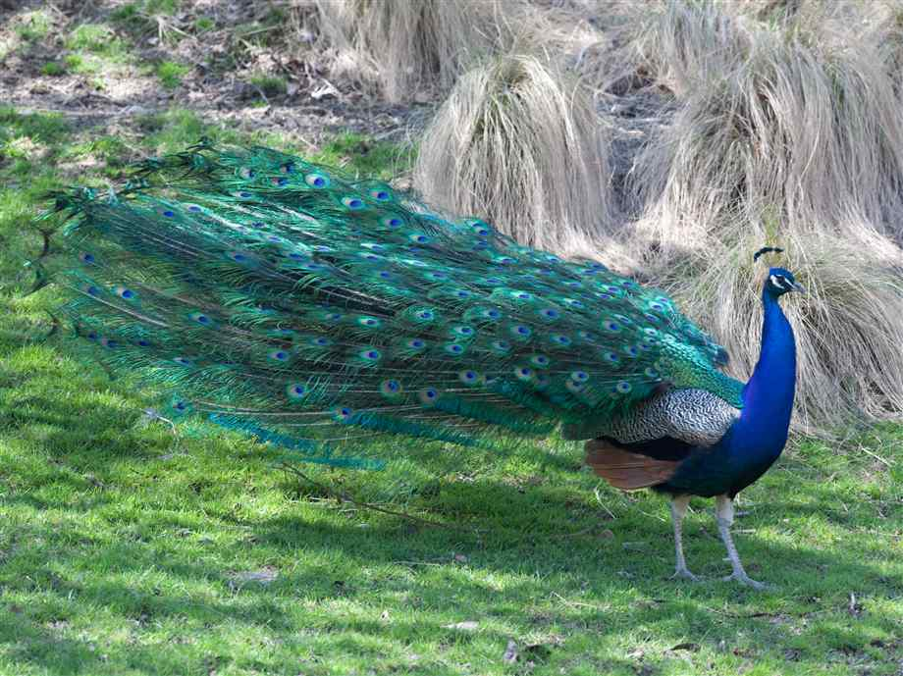

Slide 107
15. MAYURASANA
Type : Sitting
Category : Cultural – Balancing
Counts : 10
Compl. Posture : No Compl.

Slide 108
Benefits
Makes the wrists flexible, Arms become strong
Tones the abdomen and reduces fat on the tummy
Digestion improves
Removes constipation
Activates the pancreas
Improves appetite
Good for irritable bowel

Slide 109
Limitations
Hernia, hyper acidity and ulcers
Women with menstrual problems
Key Points
Elbows on either side of the Navel
Lift the head first and then the legs
Keeping the knees straight elevate the legs higher
The weight of the body on the abdomen

Slide 110
16. Ardha Sirsasana
Type : Sitting
Category : Cultural-Balancing
Counts : 10
Compl. Posture : Nil

Slide 111
Benefits
Prepares for Sirsasana.
Improves circulation in the head.
Good for reducing tension headache.
Limitations
High Blood pressure and Heart problems.
Ear inflammations.
Severe asthma.
Cold or Sinusitis.
Slip disc, weak spine, and vertigo

Slide 112
Key Points
Crown of the head should be on the ground and the interlocked palms should support the back of the head.
The elbows and the head together make an equilateral triangle

Slide 113
17. Sirsasana
Type : Sitting
Category : Cultural-Balancing
Counts : 10
Compl. Posture : Nil

Slide 114
Benefits
Makes the nervous system healthy
Improves the concentration and memory
Limitations
Running ear.
Heart problem, High blood pressure.

Slide 115
Key Points
Crown of the head should be on the ground and the interlocked palms should support the back of the head.
The elbows and the head together make an equilateral triangle
Beginners should do very slowly. Maintain short time.
Practice under guidance.
After returning to shiti it is mandatory to rest for a while in the following position.
Make a fist of both the palms and place them one above the other in front of the knees. Slowly bend forward to rest the forehead on the pressure in the head gets lighter. Then relax in Tadasana so that the pressure in the head comes back to normalcy.

Slide 116
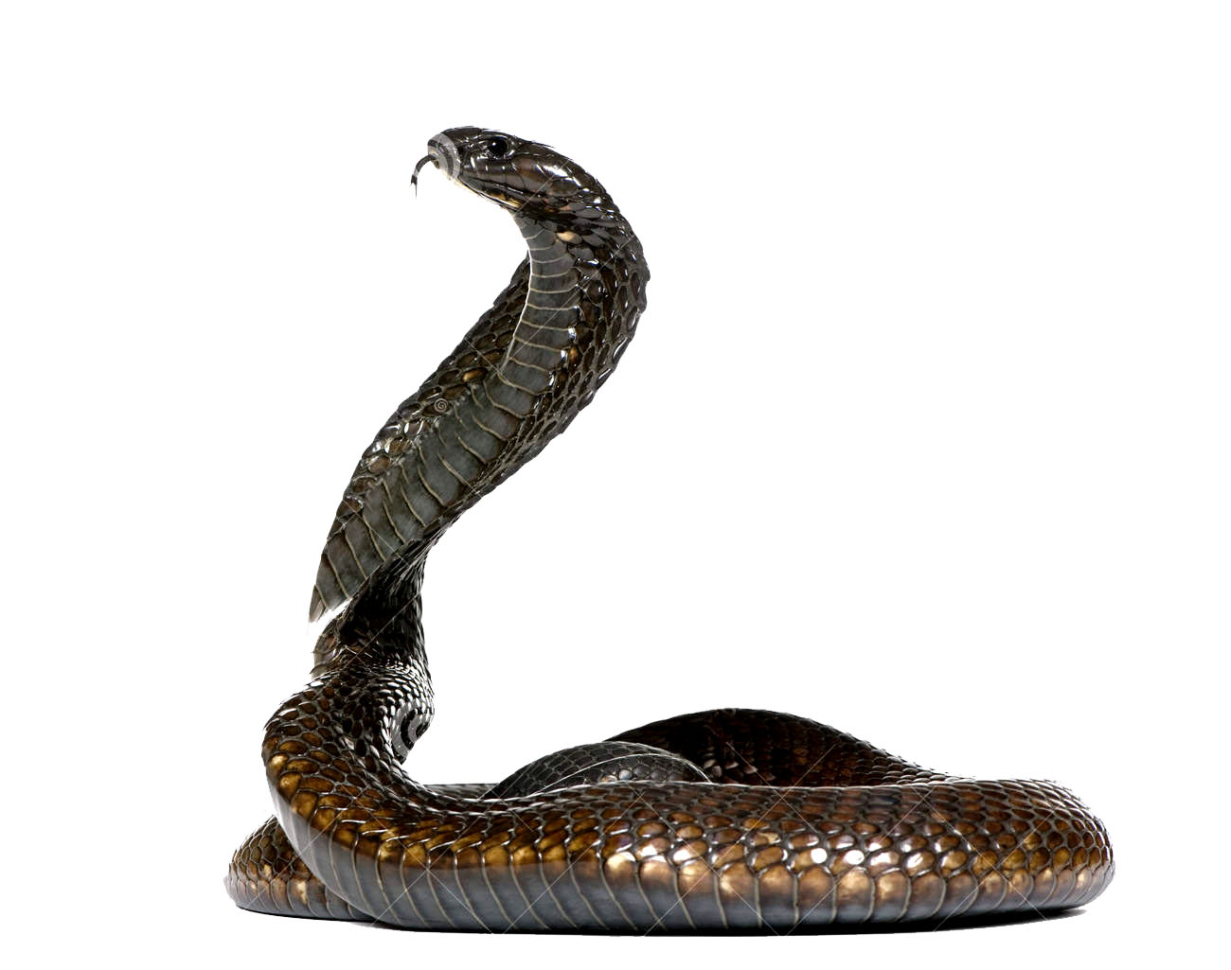

Slide 117
18. Bhujangasana
(Serpent Posture)
Type : Prone
Category : Cultural
Counts : 4
Compl. Posture : Salabhasana

Slide 118
Benefits
Flexibility to the dorsal spine.
Strengthens the spinal muscles.
Prevents back pain.
Reduces abdominal fat.
Useful in managing bronchial problems.
Limitations
Recent abdominal surgery
Cervical spondylosis.

Slide 119
Key Points
Palms by the sides of last rib bones.
Elbows as close to the body as possible.
Body should be raised up to that extent that the navel is about to leave the ground.
Legs and feet together and on the ground.

Slide 120
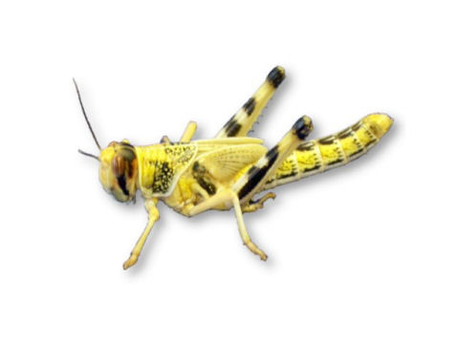

Slide 121
19. Salabhasana
(Locust Posture)
Type : Prone
Category : Cultural
Counts : 4
Compl. Posture : Bhujangasana

Slide 122
Benefits
Helps to manage sciatica and lower backache.
Tones the hip muscles.
Limitations: Cardiac patients.

Slide 123
Key Points
Both feet together.
No bending the knees.
Give a backward up push to the feet to raise up.
Chin on the ground.
Awareness on the thyroid.

Slide 124


Slide 125
20. Dhanurasana
(Bow Posture)
Type : Prone
Category : Cultural
Counts : 4
Compl. Posture : Nil

Slide 126
Benefits
Stimulates and slims the body.
Gives good stimulation and flexibility to the back
Limitations: Any health problem
Key points
Both feet together.
Hold only the ankles not the toes.
Give a backward up push to the legs.

Slide 127
21. Viparita-Karani
(Half-Shoulder Stand)
Type : Supine
Category : Cultural
Counts : 8
Compl. Posture : Matsyasana

Slide 128
Benefits
Relaxes the spinal muscles.
Helps to cure constipation and GID.
Helps to cure Menstrual Disorders
Limitations
Cervical Spondylosis.
Spinal problems.
Hypertension.

Slide 129
Key Points
Trunk should make 45⁰ to the ground.
Legs should be straight.
While bringing the legs down care should be taken not to raise the head.

Slide 130
22. Sarvangasana
(Shoulder-stand Posture)
Type : Supine
Category : Cultural
Counts : 8
Compl. Posture : Matsyasana

Slide 131
Benefits
Stimulates the thyroid gland.
Influences the pelvic organs.
Helps to cure varicose veins, piles, hernia.
Helps to cure constipation and menstrual disorders.
Limitations
Cervical Spondylosis.
Severe Hypertension.

Slide 132
Key Points
Trunk should make 90⁰ to the ground.
Legs should be straight.
While supporting the body elbows should be close to each other.
While bringing the legs down care should be taken not to raise the head.

Slide 133


Slide 134
23. Matsyasana
(Fish Posture)
Type : Supine
Category : Cultural
Counts : 8
Compl. Posture : Sarvangasana

Slide 135
Benefits
Good for
Asthmatics
Respiratory problems
Limitations
Recent abdominal or thoracic surgery
Cervical spondylosis.

Slide 136
Key Points
Crown of the head on the ground.
Press the elbows on the ground and allow the weight of the body to go to ground through elbows.
Give a nice backward stretch for dorsal and cervical spines

Slide 137
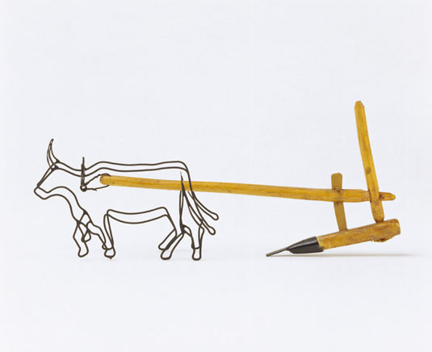
Halasana

Slide 138
24. Halasana
(Plough Posture)
Type : Supine
Category : Cultural
Counts : 8
Compl. Posture : Cakrasana

Slide 139
Benefits
Stretches and stimulate the back muscles, spinal joints and lumbar nerves.
Enhances blood flow to the neck.
Keeps the spine flexible.
Limitations
Spinal problem.
Cardiac problem.
Hypertension.

Slide 140
Halasana
Key points
Make the knees straight.
Walk back making the trunk erect.
While coming back take care not to raise the head
Make sure that perfect balance is achieved before the arms are releasing support to the trunk

Slide 141
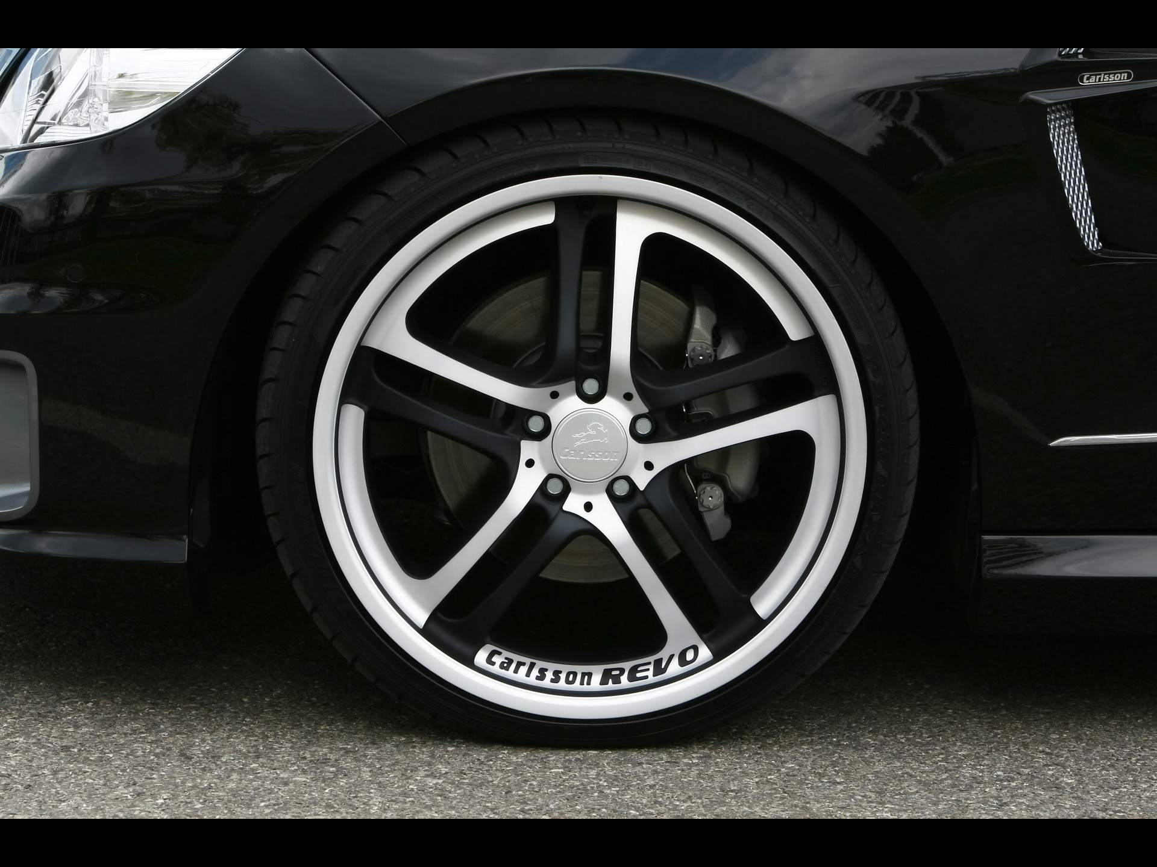

Slide 142
25. Cakrasana
(Wheel Posture)
Type : Supine
Category : Cultural
Counts : 4
Compl. Posture : Halasana

Slide 143
Benefits
Brings flexibility to the spine.
Stimulates all parts of the body.
Strengthens the arms, shoulders and legs.
Limitations: Any kind of disease
Bring the heels closure to the buttocks.
While coming back first head should reach the ground then the back and then the buttocks.

Slide 144
DRT (Deep Relaxation Technique)
Phase I- Relax the lower part of the body (toes to waist). Chant A-kara.
Phase II- Relax the middle part of the body (abdomen to neck). Chant U-kara.
Phase III- Relax the upper part of the body (head region). Chant M- kara
Phase IV- Observe the whole body relaxed. Chant A-U-M in a ratio 1:1:2.

Slide 145
Phase V- Come out of body consciousness/ body apartness.
Phase VI- Expand your awareness to the blue sky, visualize it.
Phase VII- Feel that blissful all-pervasive awareness. (merging with the sky)
Phase VIII- Come back to body consciousness. Chant Om-kar.

Slide 146
Closing Prayer
“ Yogena Cittasya Padena Vacam,
Malam Sarirasya Ca Vaidyakena,
Yo Pakarotam Pravaram Muninam,
Patanjalim Pranjaliranatosmi,
Om Santih Santih Santih.”
Meaning:
I offer my salutations with fold hands to patanjali the renowned amongst the sages, who removed the impurity of mind through yoga, of speech by grammar and of body by ayurveda. Om peace peace peace.

